Slide 1
AP Gov—11/4/2015
Please have out your HW questions to discuss as a class
Intro to Elections: Caucuses & primaries
Homework:
Begin reading CH. 9, pgs. 290-298
Make sure you are keeping up on KBAT’s (there is a pretty lengthy list of SCOTUS cases with this unit)

Slide 2
Quiz Corrections
You have until Friday to complete test corrections
You will get ½ back per questions
Must include
Question # you got wrong
Explanation of why the answer you chose was wrong
Correct answer

Slide 3
Electoral Process
CH. 9- Campaigns & Voting Behavior

Slide 4
CAUCUSES AND PRIMARIES

Slide 5
Types of Primaries
Closed
Format used in most states
Only registered party members can vote for partisan offices
No crossing party lines!
Open
Independents may vote
Ballot of any one party the voter wants
Crossing party lines allowed
Trend is favoring open primaries
Danger of “raid”
Blanket
Pretty much anything goes!
Independents can vote
Voters can “mix and match”/split-ticket

Slide 6
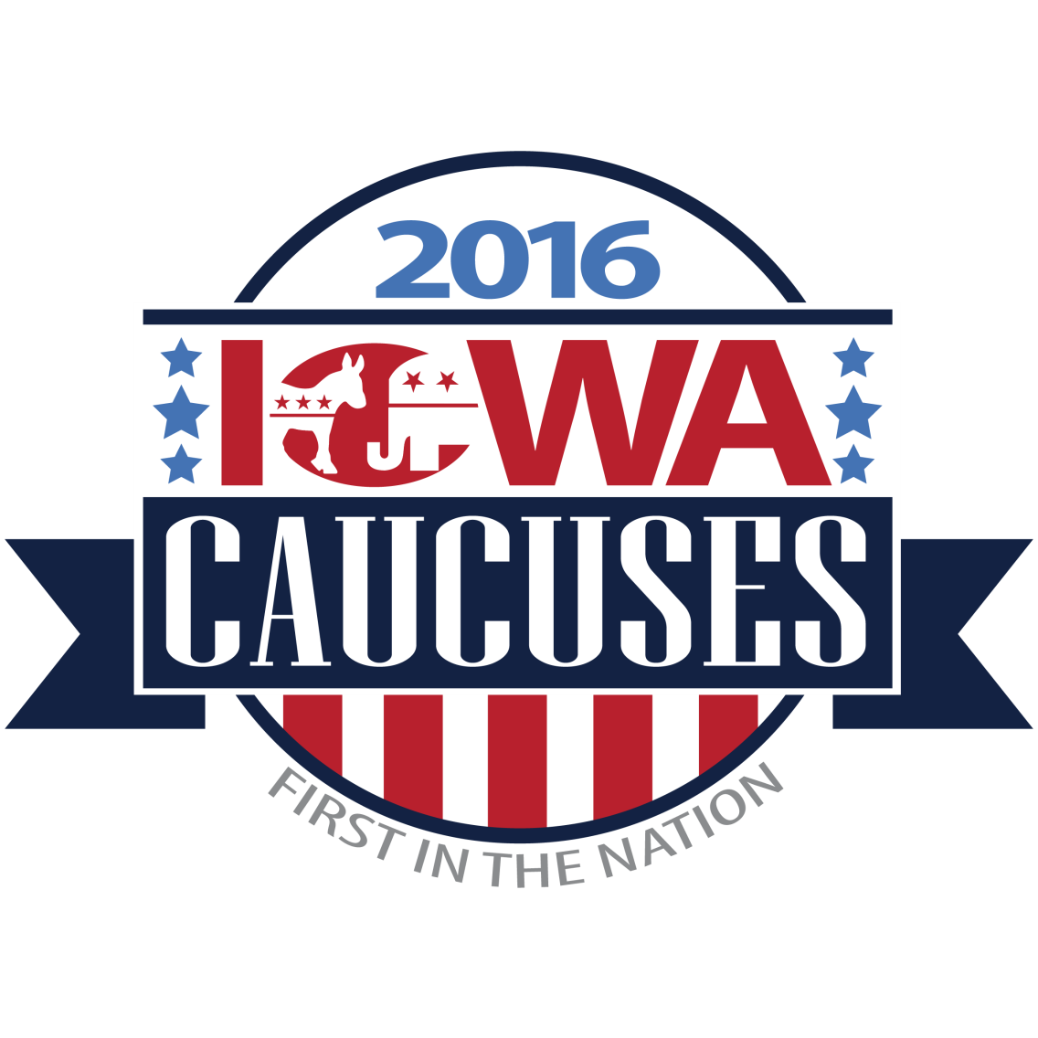
Iowa Caucuses
First test of a candidates-vote getting ability
Media frenzy!
Narrows the field of viable candidates
Iowa Caucus explained
Inside the caucus

Slide 7
AP Gov—11/5/2015
Please have your notebooks out
Primary elections
Congressional elections
Homework:
Edwards pgs. 290-298
Quiz corrections due tomorrow

Slide 8
Warm up
Identify and explain the 3 types of traditional primaries?
Explain the Iowa Caucuses. What is a caucus? Why does Iowa matter so much?
Predict: What could be potential problems with the primary system we have now?

Slide 9
What do we have in Washington?
For Congressional elections (and most other positions):
Top 2 primary
Voters don’t have to declare party affiliation
System was changed by initiative passed in 2004, upheld by SCOTUS
For Presidential election:
Open primary + caucusing
Precinct caucuses will be on March 26th

Slide 10
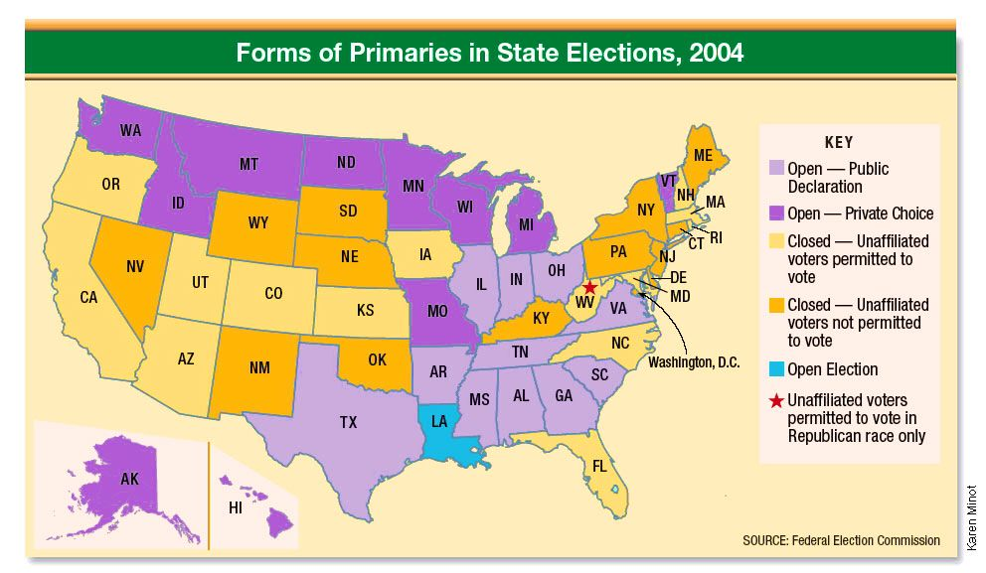

Slide 11
“Frontloading”
States move up their primaries to capitalize on the media attention
Delegates choose candidates within weeks of the Iowa caucus and NH primary
Potential problems:
Rush to judgement
Late primaries are irrelevant

Slide 12
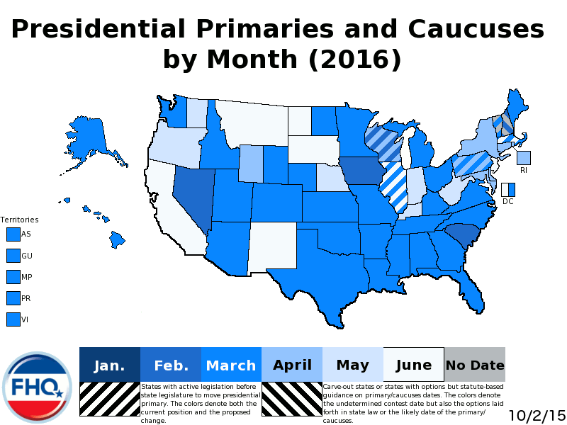

Slide 13
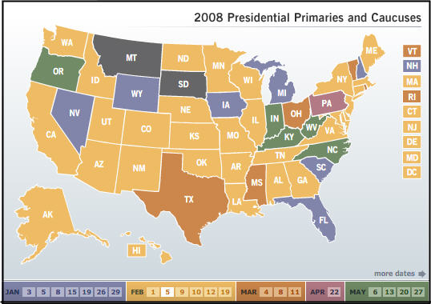

Slide 14
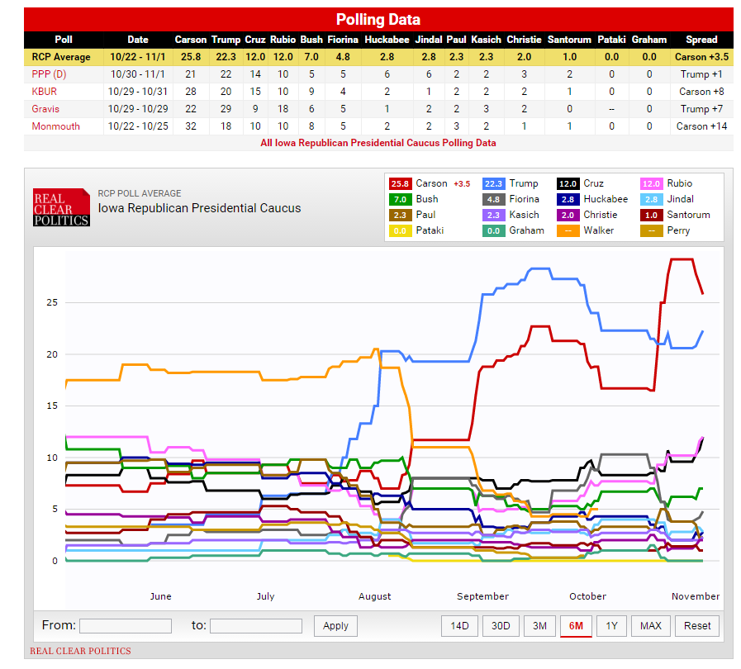

Slide 15
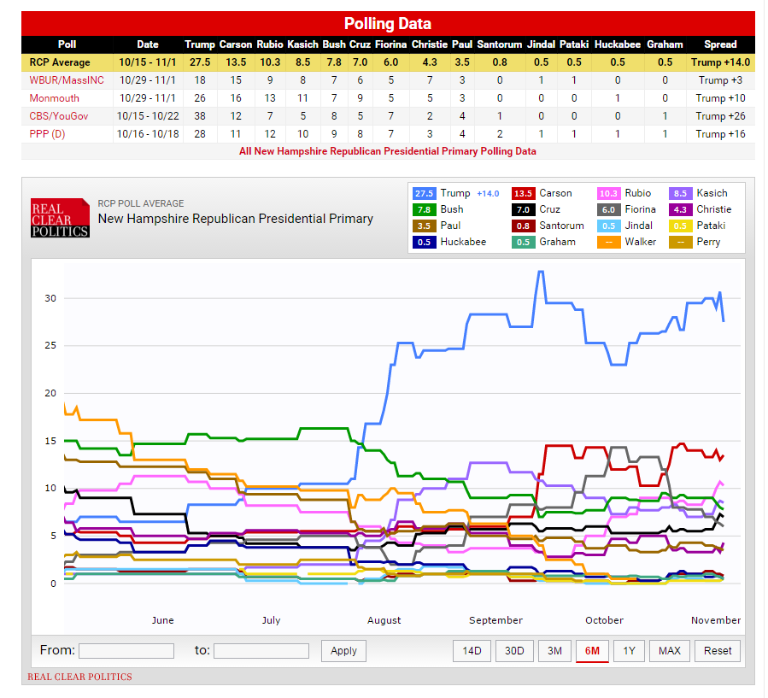

Slide 16
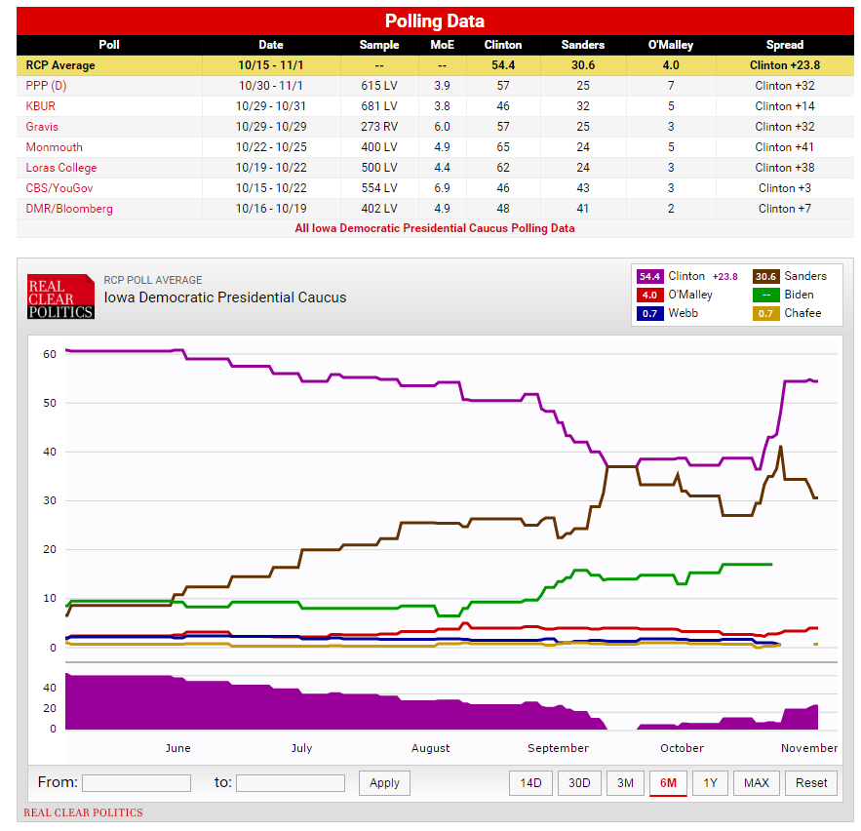

Slide 17
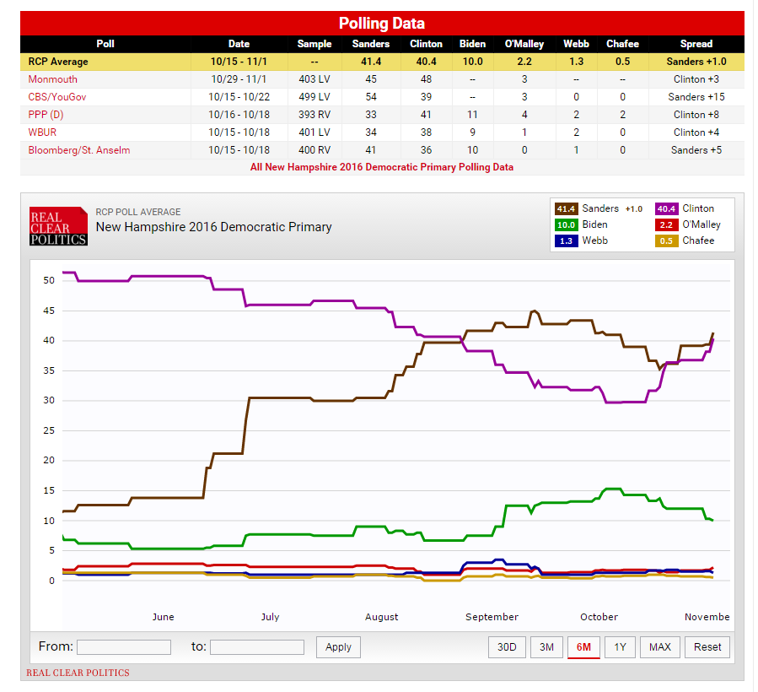

Slide 18
Evaluating the system
Disproportionate attention goes to early states
Prominent politicians find it difficult to take time out to run
Money plays too big a role
Participation in primaries and caucuses is low and unrepresentative
Too much power to the media: HORSERACE!

Slide 19
Are there any solutions to the problems presented by the primary system?
Does it need to be reformed?

Slide 20
AP Gov—11/6/2015
TGIF!
Please grab an article from the back. Begin reading. What concept related to elections is it explaining?
Path to the Presidency!
State demographics & voting behavior activity
Homework:
Edwards pgs. 307-313
Current Events—try to find something related to elections/primaries/political parties

Slide 21
Invisible Primary
Unofficial campaigning done by unofficial candidates

Slide 22
PATH TO THE PRESIDENCY

Slide 24
Primaries & Caucuses
Primary
Caucus
Increased use in last 30 years
Voters vote for candidates and state parties select delegates to attend Nat’l Convention
Local caucus to district convention to state convention to nat’l convention
Each level selects delegates to attend higher level

Slide 25
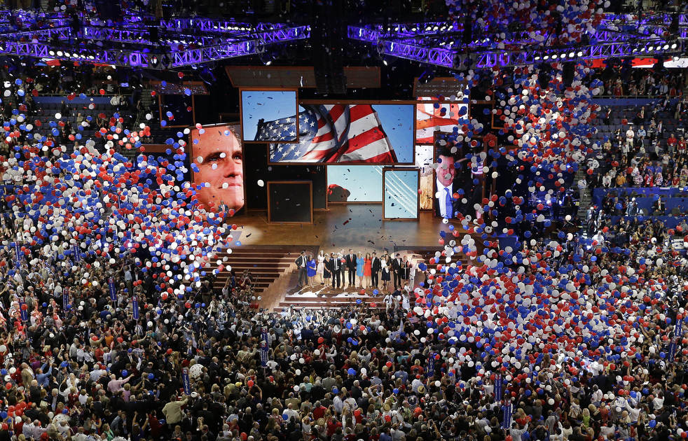
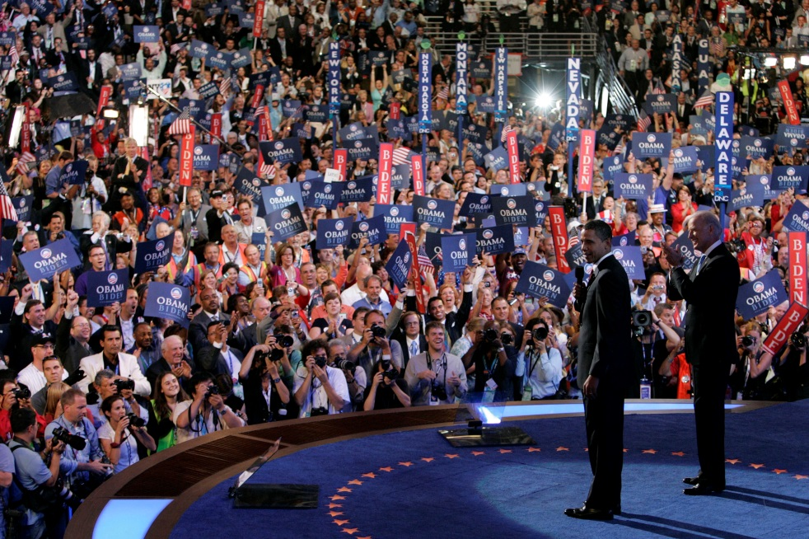
National Convention
Selection of presidential nominee
Mere formality
More about the image
Selection of vice president
Chosen by nominee and “stamped” by convention
“Balancing the ticket”
Development of party platform
Reconciliation & unification

Slide 26
Analysis of nominating system
PRO
CON
Highly participatory (or at least lots of opportunity)
Highly representative
Testing ground for candidates
Low rates of turnout
Too lengthy
Does not test qualities needed to be President
Too much of a media game
Frontloading
Voters in primaries tend to be better educated & more affluent then general election
Delegates are unrepresentative

Slide 27
After the nomination…
Fall campaigning
Election Day
Meeting of the Electors
Formal election
Inauguration Day
Next week we will look at campaign ads, the Electoral College, who votes, redistricting and campaign finance reform!

Slide 28
So who is voting for who?
Your task:
Pick a state of your choice and look at the demographics of the state, and the voting behavior in the last 4 elections
How does it differ from the rest of the nation?
U.S. Census Bureau if best for demographics
CNN Election Center is best for election results
http://www.cnn.com/election/2012/results/race/president/

Slide 29
AP Gov—11/9/2015
Good afternoon! Current Events
Have out your worksheet: State demographics & voting behavior
Exit polls
Factors affecting voter turnout
Homework:
Edwards pgs. 301-306 by Friday
Supplemental readings+ q’s due Friday

Slide 30
So who is voting for who?
Your task:
Pick a state of your choice and look at the demographics of the state, and the voting behavior in the last 4 elections
How does it differ from the rest of the nation?
U.S. Census Bureau if best for demographics
Religion: http://www.pewforum.org/religious-landscape-study/
CNN Election Center is best for election results
http://www.cnn.com/election/2012/results/race/president/
As you finish, take some time checking out exit polls from the past few elections. Anything that doesn’t match up with what we know about voting behavior by demographic?

Slide 31
AP Gov—11/10/2015
Good afternoon!
Voting behavior & voter turnout
Debate tonight
Homework:
Edwards pgs. 301-306 by Friday
Supplemental readings+ q’s due Friday

Slide 32
Voter Turnout & Voting Behavior

Slide 33
Factors Affecting Voting Behavior
What do we already know about who votes? Who votes for which party?
What was a key factor we identified in our activity from yesterday?

Slide 34
Factors Affecting Voting Behavior
Geography
Solid South
Great Plains
Rocky Mtn. region
New England
Great Lakes region
Far West

Slide 35
Factors Affecting Voting Behavior
Presence of a strong candidate
Time—maintaining, deviating, critical, midterm
Party identification
Demographic factors—sex, race, social class, religion
Issues
Candidate appeal

Slide 36
Voter Turnout
Does low voter turnout matter?

Slide 37
Voter Turnout
How have the qualifications for voting changed throughout our history?
What are the current qualifications?

Slide 38
Voter Turnout
Historical qualifications for suffrage
Current qualifications
Religion (state leg)
Property (state leg)
Race (15th Amendment)
Sex (19th Amendment)
Income (24th Amendment—poll tax)
Literacy (Voting Rights Act of 1965)
Minimum age of 21 (26th Amendment)
Citizenship
Residency
Age
Registration (in all states except ND)
And other state to state laws…

Slide 39
Voter turnout in the U.S.
About 55% in presidential elections
30%-40% in midterm congressional elections
Even lower in state/local elections
Steady decline since 1960
How does this compare to other industrialized nations?
As high as 90%
Multi-party systems
Automatic or same-day registration
Compulsion penalties

Slide 40
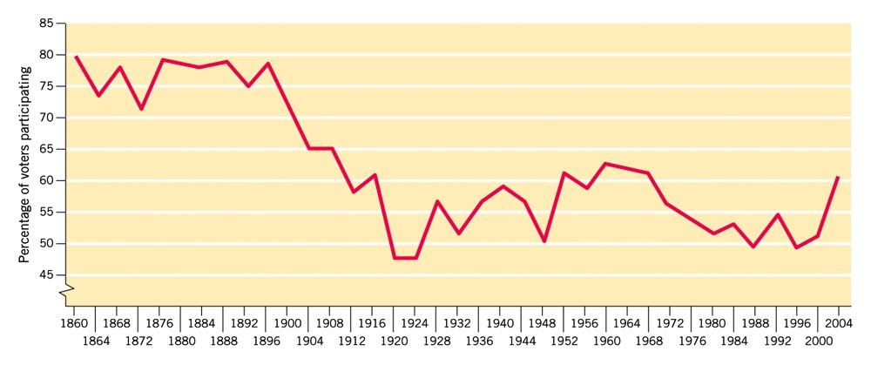
Recent Turnout
2012: ~126 million votes cast
57.5% of eligible voters
2008: ~127 million votes cast
beats 2004 by record by at least 4.3 million
60.7-61.7% of registered voters voted

Slide 41
Reasons for low voter turnout
Institutional barriers
Registration
Easing or eliminating would add about 9%
Ballot fatigue
Excessive number of elections & offices
Type of election
Difficulties obtaining absentee ballots
Young vote
Political reasons
And…why do we vote on a Tuesday?!?

Slide 42
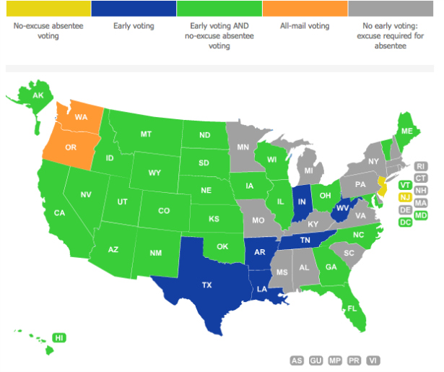

Slide 43
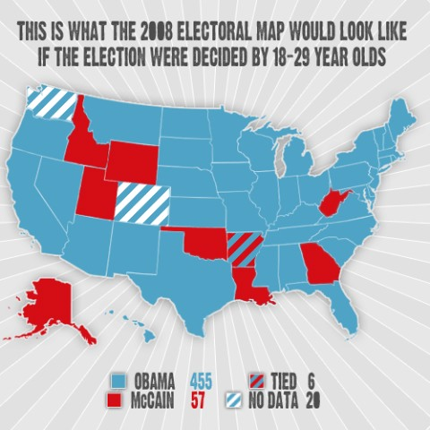

Slide 44
Who votes? Who doesn’t? Who cares?
Characteristics of those likely to vote?
Level of education is the greatest predictor of voting
Age
Race
Income
What do you think? Is low voter turnout a problem?

Slide 45
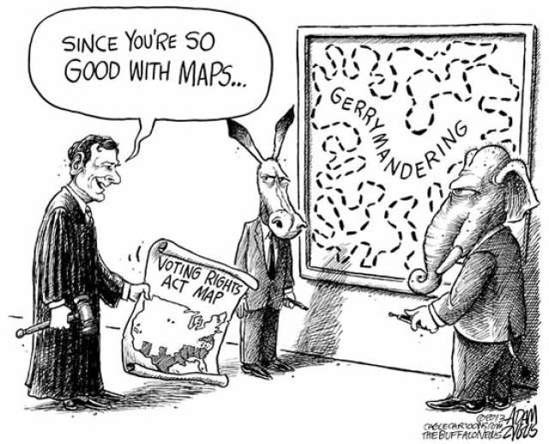
AP Gov—11/12/2015
Congressional elections
Gerrymandering & redistricting
Play the redistricting game!
Homework:
Edwards pgs. 301-306 by Friday
Supplemental readings+ summaries due Friday
Check out the redistricting graphics & links on the blog

Slide 46
Warm up
What are some of the institutional barriers associated with low voter turnout?
How does voter turnout in the U.S. compare to other industrialized nations?

Slide 47
CONGRESSIONAL ELECTIONS & REDISTRICTING

Slide 48
Congressional Elections
Regularly scheduled, unlike other countries where elections are called by gov’t at the time of its choosing
Fixed terms
Term limits imposed by states have been overturned
Winner-take-all/single member district system
And one key factor that can determine the outcome of elections…

Slide 49
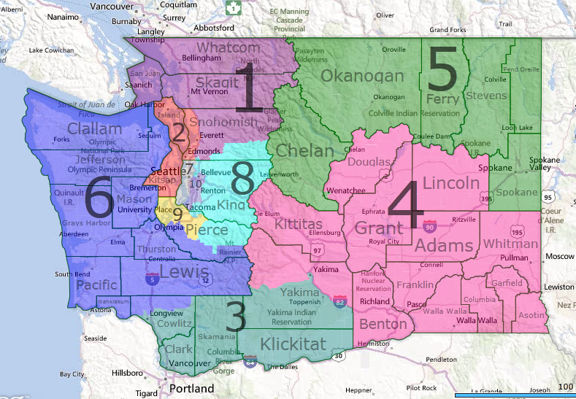
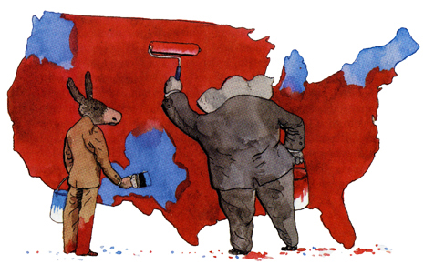
Gerrymandering
“If you are not cheating, you are not trying hard enough”—Tim Stevens
What is gerrymandering?
Manipulating boundaries to favor one party over the other

Slide 50
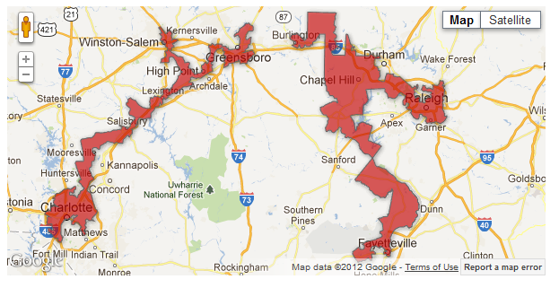
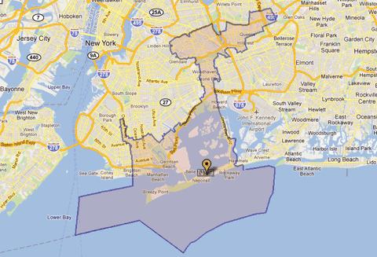
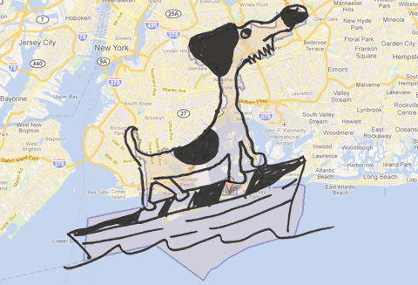
Gerrymandering
Crazy gerrymandering

Slide 51
Play the redistricting game
Go to redistrictinggame.org
Play Mission 1: Fundamentals (advanced level)
You can play for Republicans or Democrats
Helpful tips:
Click on the people’s pictures for hints and watch their face to see their level of satisfaction
You get political capital from winning elections & political favors. Sometimes you need to spend capital to get what you want
Be patient!
Play the other missions…Mission 2 is more difficult!

Slide 52
AP Gov—11/13/2015
TGIF the 13th ☺
Please have your HW out
Redistricting game
Play until your heart’s content! If you only want to play one or two more rounds, I will put on the republican debate.
Homework
Current Events
KBAT’s
Democratic debate tomorrow, CBS @ 6:00

Slide 53
Warm up
What is reapportionment?
What is redistricting? Who is responsible for the redistricting process?
How can redistricting determine elections?

Slide 54
AP Gov—11/16/2015
Grab a campaign finance chart from the back
Current Events
Campaign Finance 101
Money in the 2016 campaign
Video: “Big Sky, Big Money”
Homework:
Campaign finance chart use link on blog and notes from class (due Wednesday)
Read “Families funding the election” (NY Times)
KBAT’s

Slide 55
CAMPAIGN FINANCE

Slide 56
Federal Election Campaign Act
Passed in 1971
Post-Watergate
Established Federal Elections Commission (FEC)
All candidates must disclose contributions & expenditures
First limits on individual contributions
Regulations on political action committees (PAC’s)

Slide 57
Hard $ vs. Soft $
Hard money = Federal (regulated) money
Political donations contributed directly to a candidate of a political party
EXAMPLE: money for an ad that educates voters about issues, with a specific candidate endorsement (EXPRESSED ADVOCACY)
Soft money = Nonfederal money
Political donations and campaign contributions to parties or “party building” activities; SUBJECT TO STATE LAW
EXAMPLE: money for ads that educate voters about issues, as long as the ads don't take the crucial step of telling voters which candidates to vote for

Slide 58
Federal Elections Commission
Bipartisan
Mission to open-up details of campaigns

Slide 59
REFORMS & RESPONSES

Slide 60
Buckley v. Valeo, 1976
CONSTITUTIONAL to limit amount of money individuals or PACs can donate to party or candidate
Struck down portions of FECA that limited the amount individuals could contribute to their own campaign
Ross Perot—60 million of his own $
Mitt Romney—44 million

Slide 61
McCain-Feingold Act
Bipartisan Campaign Finance Reform Act of 2002
Attempt to limit large soft money donations
Upheld by McConnell v. FEC
Banned $ for use of advocacy if the ad identified a candidate close to election time

Slide 62
527 groups
Not subject to restrictions as long as they do not make a clear political endorsement
Swift Boat Veterans for Truth: http://www.youtube.com/watch?v=phqOuEhg9yE
MoveOn.org
Although unlimited, donations are still disclosed to FEC

Slide 63
501(c) groups & Super PAC’s
501(c)
Super PAC’s
Donations are anonymous
Cannot spend more than half their funds on political activities
No limits on individual donations to PAC’s
Billionaires give to Super PAC to support candidate
Can advocate for a specific candidate

Slide 64
Citizens United v. FEC
2010
Citizens United sued for an unconstitutional restriction of free speech
Sided with Citizens United
Now corporations can endorse/oppose specific candidates

Slide 65
A guide to campaign finance
The Cost of Campaigns
https://www.youtube.com/watch?v=eXGEictCR8k&list=PL4CGYNsoW2iAOqPtxm4RHo205w_R1IWuH%22

Slide 66
AP Gov—11/17/2015
Good afternoon!
Continue campaign finance
“Big Sky, Big Money” video
Homework:
Campaign finance chart use link on blog and notes from class (due tomorrow)
Read “Families funding the election” (NY Times)
KBAT’s

Slide 67
Warm Up
I am a non-profit, tax-exempt group with no limits on contributions. Only half of my “mission” can be focused on campaigning. All my donors are anonymous/undisclosed.
I am a 501(c) group

Slide 68
I am an interest group that pools money from various sources and then donates it to candidates and political parties. Donors can give me up to $5,000 per year, and then I can give up to $5,000 to a candidate per election year. I am regulated by the FEC.
I am a PAC

Slide 69
I am fairly new in the world of politics and VERY influential. I can advocate for a specific candidate but not give money directly to them. There are no limits on who can contribute and how much they can contribute. I am regulated by the FEC.
I am a Super PAC

Slide 70
I am a non-profit, tax-exempt group with no limits on contributions. I cannot expressly advocate for/against a specific candidate or give money to a political party. My donors will eventually be disclosed to the IRS.
I am a 527 group

Slide 71
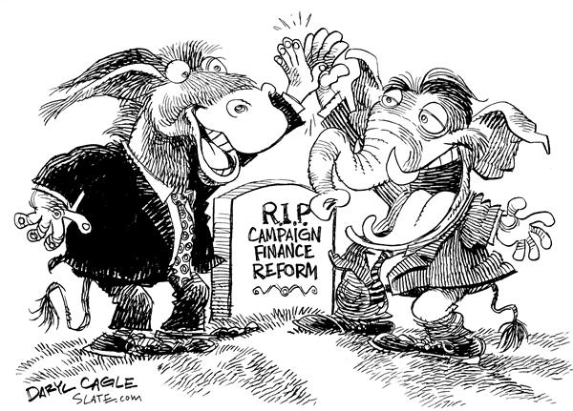
AP Gov—11/18/2015
Please have your campaign finance chart out. What is still unclear?
Finish up “Big Sky, Big Money”
Discussion: Do we need to reform our campaign finance system again?
Homework:
Edwards pgs. 318-323
Unit 3 Test Monday

Slide 72
4 at a time discussion
5 chairs, never more than 4 people up front
Do we need to reform the campaign finance system? What would be the most pressing reform?
Should Citizens United v. FEC be overturned?
Who benefits most from our current system? Who does it hurt most?

Slide 73
AP Gov—11/19/2015
Good morning!
Electoral College
Criticisms & alternatives
Discussion: Should we abolish the Electoral College?
Homework:
KBAT’s
Study for your test! A bit of review time/FRQ practice tomorrow

Slide 74
PATH TO THE PRESIDENCY
Electoral College

Slide 75
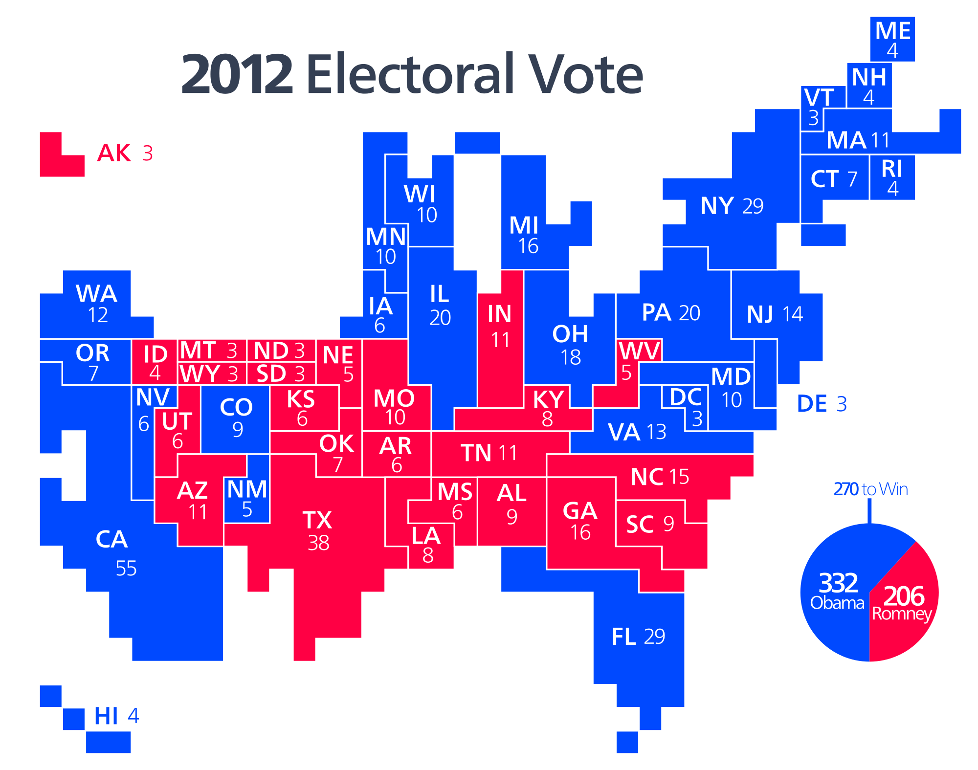

Slide 76
Rationale
Poor communication
Desire to have the “best” people to select president
Compromise!

Slide 77
Allotment of Electoral Votes
Each state has as many electoral votes as it has members in Congress
Minimum—3 votes
Total 538 votes (3 votes to DC)
California has highest number—55

Slide 78
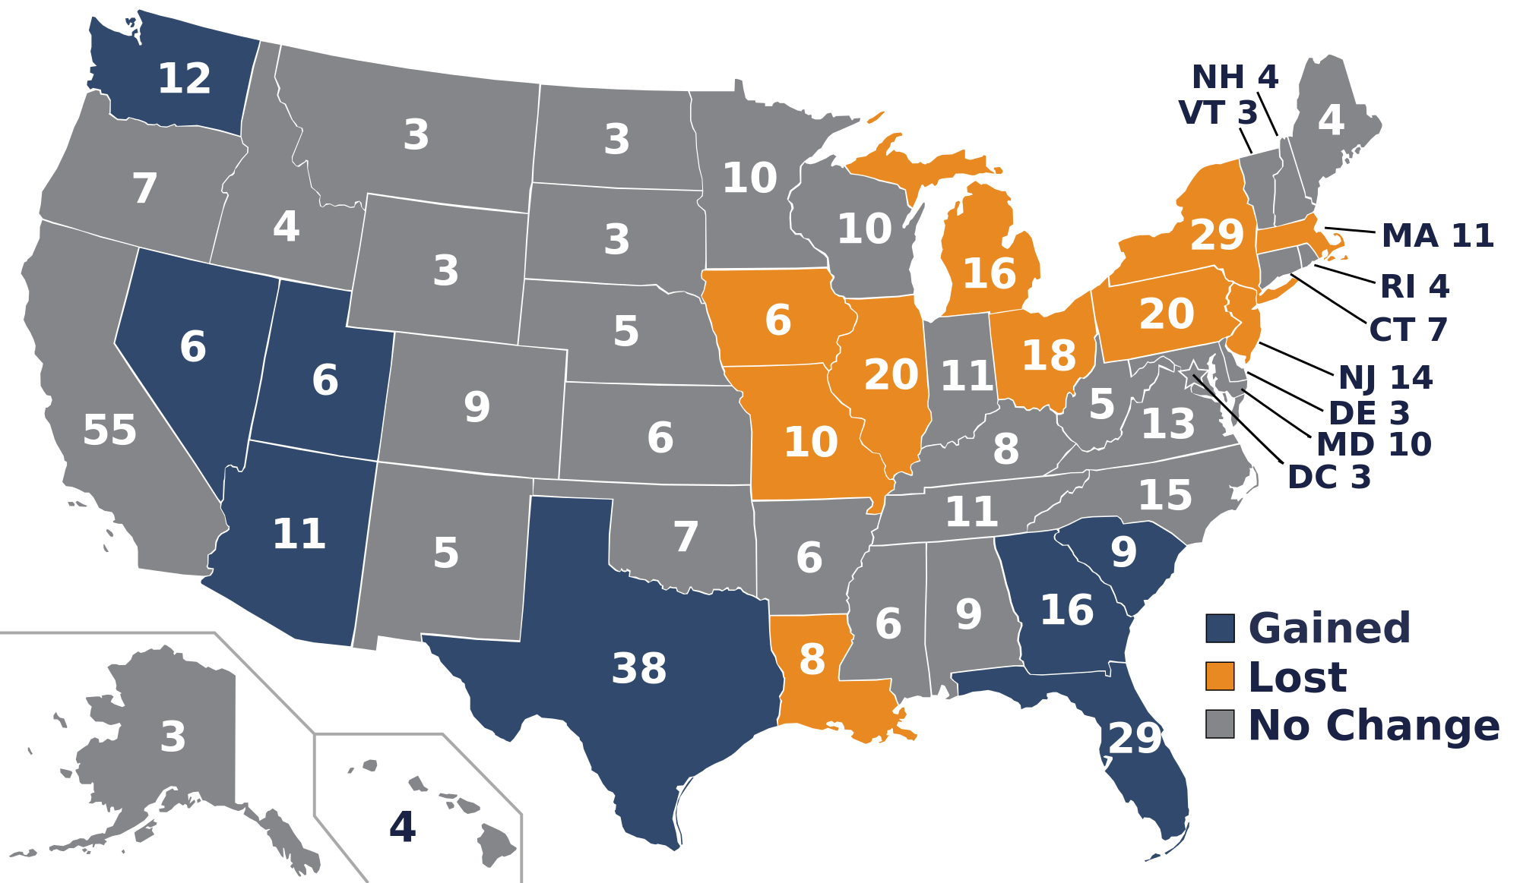

Slide 79
Selection of Electors
Each party develops a “slate” of electors prior to election

Slide 80
Winning Electoral Votes
Candidate with most popular votes (plurality) wins all the state’s electoral votes (winner-take-all)
Concentration of campaigning in large, competitive states (swing states)
Electors meet in December to cast ballots

Slide 81
Winning the Election
Majority of electoral votes
270 to win
If no candidate has the majority
House selects from top 3 candidates
Each state has one vote
Senate selects vice pres. from top 2 candidates

Slide 82
Criticisms
President can be elected with a plurality, not a majority, of popular votes
Possibility of minority president
“Faithless electors”—no law that requires electors to vote the way they are supposed to
Small states are proportionately overrepresented
And ridiculously overrepresented if decision goes to the House
Inhibits development of third parties
(Clip)

Slide 83
Alternatives
Direct election—one person, one vote
District system
Proportional system
Keep electoral votes, but abolish electors

Slide 84
So why hasn’t the EC been abolished?
Tradition!
Difficulties in amending the Constitution
Opposition from small states

Slide 85
Discuss

Slide 86
4 at a time discussion
5 chairs, never more than 4 people up front
Should we abolish the Electoral College? If so, what kind of system should we adopt?
Who benefits most from the current system? Who does it hurt most?

Slide 87
4 at a time discussion
5 chairs, never more than 4 people up front
Do we need to reform the campaign finance system? What would be the most pressing reform?
Should Citizens United v. FEC be overturned?
Who benefits most from our current system? Who does it hurt most?

Slide 88
AP Gov—11/20/2015
Good morning!
Unit 3 (Electoral Process) Review
FRQ’s
Multiple choice practice
Independent work time: KBAT’s
Homework:
Unit 3/Ch. 8-9 Test Monday
KBAT’s, voter demographics, campaign finance chart due Monday
Current Events Tuesday

Slide 89
With your partner
Write 1 FRQ pertaining to campaigns/elections
Trade FRQ with another pair and answer in a detailed outline

