Slide 1
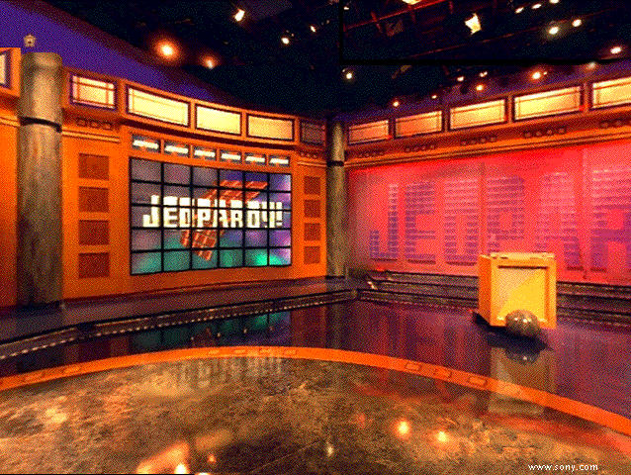
Industrial
Revolution
Jeopardy!

Slide 2
Rules:
Each group will take turns getting a chance to give the first answer.
If your group misses it, the question goes to the next team.
You must be nicely competitive – support each other. Put anyone down and you’re out of the game.

Slide 3
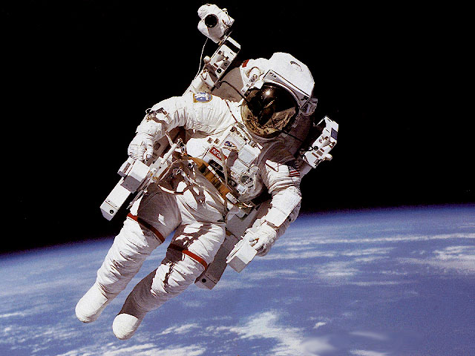
Industrial Rev. Jeopardy
Causes | People | Big Ideas | Effects | New I.R.
100
100
100
100
100
200
200
200
200
200
300
300
300
300
300
400
400
400
400
400
500
500
500
500
500
FINAL

Slide 4
Causes 100
The Industrial Revolution began in this country:
England

Slide 5
Causes 200
Large farms with better seeding and harvesting methods were called…
Enclosures

Slide 6
Causes 300
This did all of the following: spurred growth of industry, created jobs & boosted farming/fishing industries…
Invention of Railroads

Slide 7
Causes 400
As Industrialization grew, the number of cities doubled. This is called…
Urbanization

Slide 8
Causes 500
England had what 3 factors of production or goldilocks conditions?
Land, Labor, Capital

Slide 9
People 100
This person is the founder of the ideas of Communism.
Karl Marx

Slide 10
People 200
The new class of people included skilled workers, professionals and business people.
Middle class

Slide 11
People 300
This person is called “the father of Capitalism”
Adam Smith

Slide 12
People 400
People are taxed highly in order to provide public services under this economic system.
Socialism

Slide 13
People 500
A “horizontal integrator” in the oil business, this captain of industry was one of the wealthiest and most powerful men in the US during industrialization
Rockefeller

Slide 14
Big Ideas 100
Workers created groups called ____to fight for their interests.
Labor Unions

Slide 15
Big Ideas 200
People who brought together labor, capital and raw materials, and created businesses were called _____.
Entrepreneurs

Slide 16
DAILY DOUBLE! Big Ideas 300
The Industrial Revolution. led people to move to _______________.
Cities

Slide 17
Big Ideas 400
The invention that gave power to industry, trains & boats in the first I.R. was called…
Steam Engine

Slide 18
Big Ideas 500
Enclosures & crop rotation of the Agricultural Revolution all lead to this, making the whole Industrial Revolution possible
Population Growth

Slide 19
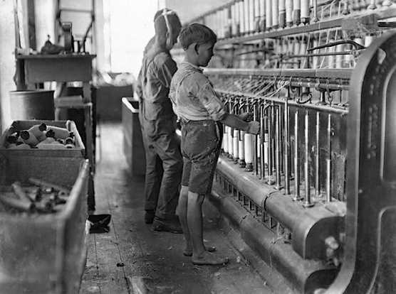
Effects 100
This picture shows:
Child Labor

Slide 20
Effects 200
This industry benefitted the most from new inventions of the first I.R.
Textile

Slide 21
DAILY DOUBLE – Effects 300
The I.R. led to the rise of ___________, which created monopolies, stock exchanges and industrializers like Rockefeller & Carnegie
Big Business

Slide 22
Effects 400
The greatest happiness for the greatest number was the goal of this new way of thinking.
Utilitarianism

Slide 23
Effects 500
This economic policy of Capitalism calls for government to “leave alone” private business
Laissez-faire

Slide 24
New IR 100
This reform of New IR taught children the 3 R’s and also important traits like obedience and punctuality
Public schooling

Slide 25
New IR 200
This year is the rough dividing line between new and old industrialization.
1870

Slide 26
New IR 300
One supplier of a particular good/service who dominates the entire industry would be considered to have this
A Monopoly

Slide 27
New IR 400
In this production method, workers repeatedly perform one task in the manufacturing process
Assembly Line

Slide 28
New IR 500
This process made the production of steel quicker, purer, & cheaper, leading to a boom in building and manufacturing.
Bessemer Process

Slide 29
FINAL JEOPARDY!
This theory created by Herbert Spencer applied the idea of natural selection to the development of business and society.
Social Darwinism

